Slide 1
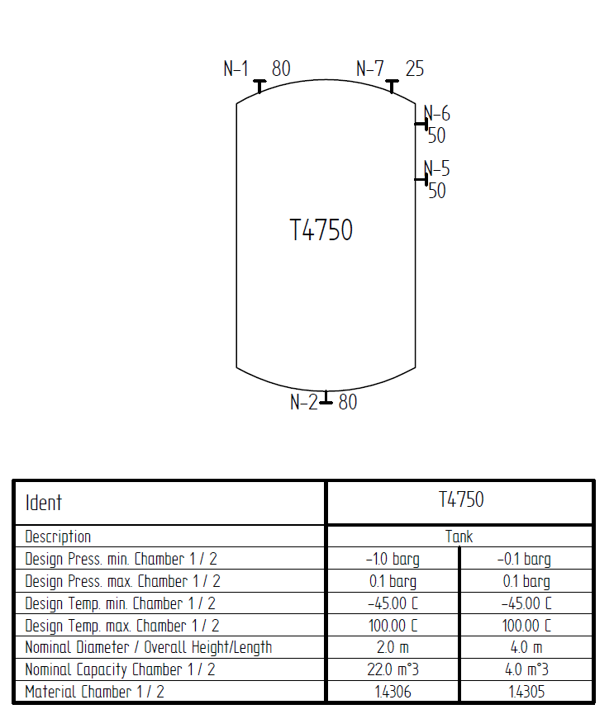
Test Case E02 – Tank T100 with Nozzles

